Slide 1
Agent2Agent (A2A) Protocol

Slide 2
Introduction
The Agent2Agent Protocol (A2A), created by Google, is a set of rules that helps different AI agents talk to each other and work together, even if they are built using different tools or by different companies.
Its main goal is to make it easier for these agents to share information, coordinate tasks, and team up effectively, especially in complicated systems where many agents are involved.

Slide 3
Purpose of A2A Protocol
Seamless Interoperability: Agents should be able to work together even if they come from different backgrounds (e.g., OpenAI agent collaborating with Google's or Meta's agent).
Dynamic Discovery: Agents can find new partners in real-time and start working without human intervention.
Decentralized Communication: No need for a central controller or orchestrator.

Slide 4
Key Features
Open-source and freely available.
Vendor-neutral: Not tied to any particular cloud or platform.
Dynamic and scalable: Agents can join or leave without breaking the system.
Platform-agnostic: Works across different environments (cloud, edge, local servers).
Extensible: Future agents or models can easily be added.

Slide 5
Architecture Overview
Agent Discovery Layer: Agents register themselves and discover other agents.
Messaging Layer: Agents exchange structured task requests, responses, and status messages.
Task Coordination Layer: Agents collaborate, split, or delegate tasks across the ecosystem.
Execution Layer: Microservices independently process their assigned tasks and return results.

Slide 6
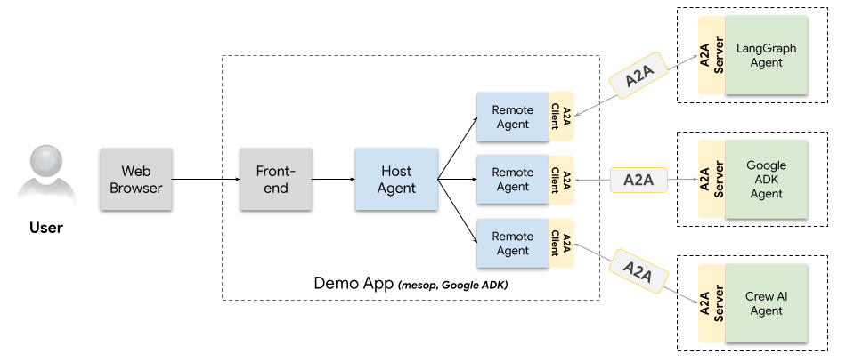
agents talking to other agents over A2A

Slide 7
A2A Workflow
1.Agent Registration
Each agent registers itself with a Discovery Service.
Registration includes:
Agent name and ID
Capabilities
Communication endpoints
Authentication credentials if needed
2.Agent Discovery
When an agent needs help with a task, it queries the Discovery Service.
The agent finds other agents that can handle specific tasks based on their advertised capabilities.

Slide 8
A2A Workflow
3.Message Sending
Using A2A Standard Message Formats structured like JSON.
Sends a Task Request Message to the selected agent.
Message includes task description, input parameters, and desired output format.
4.Task Execution
The receiving agent accepts the task.
It performs its specialized operation (e.g., data retrieval, processing, reasoning, etc.).
During execution, the agent may:
Work independently
Further delegate subtasks to other agents via A2A

Slide 9
A2A Workflow
5.Status Updates
Agents may send Status Update Messages during task execution:
Started
In progress
Partial results
Errors (if any)
6.Task Completion
After task execution:
The agent sends a Response Message back to the requester.
Response includes the result, success/failure status, and any output data.

Slide 10
A2A Workflow
7.Chained Workflows (Multi-Agent Collaboration)
In complex workflows:
Multiple agents collaborate.
An agent may process partial results and pass them on to another agent.
Chained execution leads to solving large and complex problems collectively.
8.Final Aggregation
If multiple agents contributed, a Coordinator Agent (or the requesting agent) aggregates all results.
It combines the outputs into a final report, decision, or product.

Slide 11
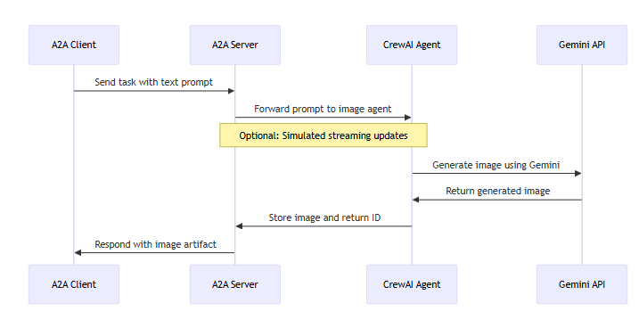
Agent-to-Agent Communication

Slide 12
Agent-to-Agent Communication
The communication between a Client and a Remote Agent is oriented towards task completion where agents collaboratively fulfill an end-user’s request. A Task object allows a Client and a Remote Agent to collaborate for completing the submitted task.
A task can be completed by a remote agent immediately or it can be long-running. For long-running tasks, the client may poll the agent for fetching the latest status. Agents can also push notifications to the client via SSE (if connected) or through an external notification service.

Slide 13
A2A and MCP

Slide 14
A2A and MCP
all the agents are communicating using the A2A protocol, it’s like their shared language.
Each agent connects to different services like search, databases, and APIs to perform specific tasks. To interact with these tools, individual agents use MCP.
In this way, A2A acts as the language for agent-to-agent communication, while MCP serves as the language for agents to communicate with tools.

Slide 15
Conclusion
Microservices in the A2A Protocol represent the future of distributed AI systems. By combining the power of independent, specialized agents with a standardized communication protocol, A2A enables scalable, resilient, and intelligent multi-agent ecosystems that can handle increasingly complex real-world tasks.

